Slide 1

Programming
Akbar Q – Mechatronics Engineering Y1 S2

Slide 2

MATLAB
Simulink will be Used to Make the Diagram

Slide 3
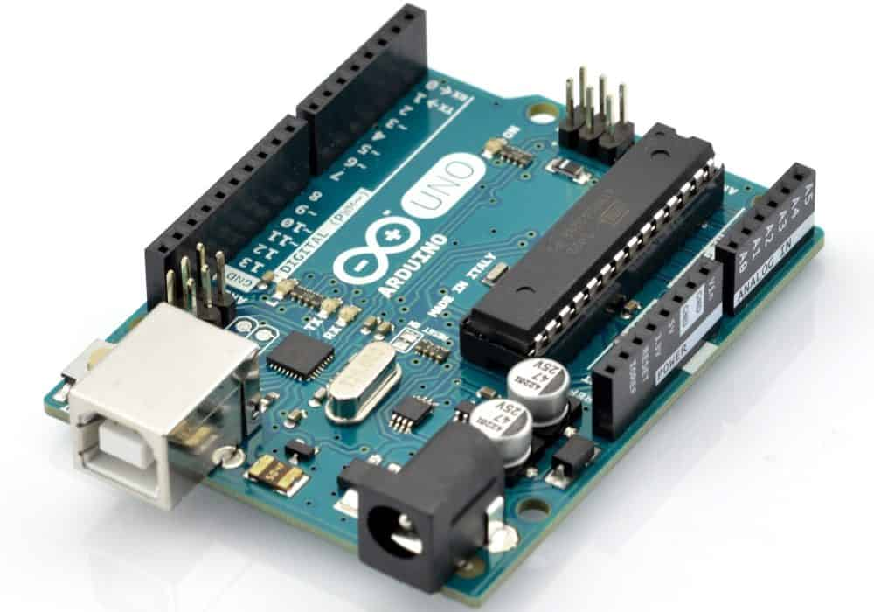

Arduino
The Arduino Library will be Utilized

Slide 4
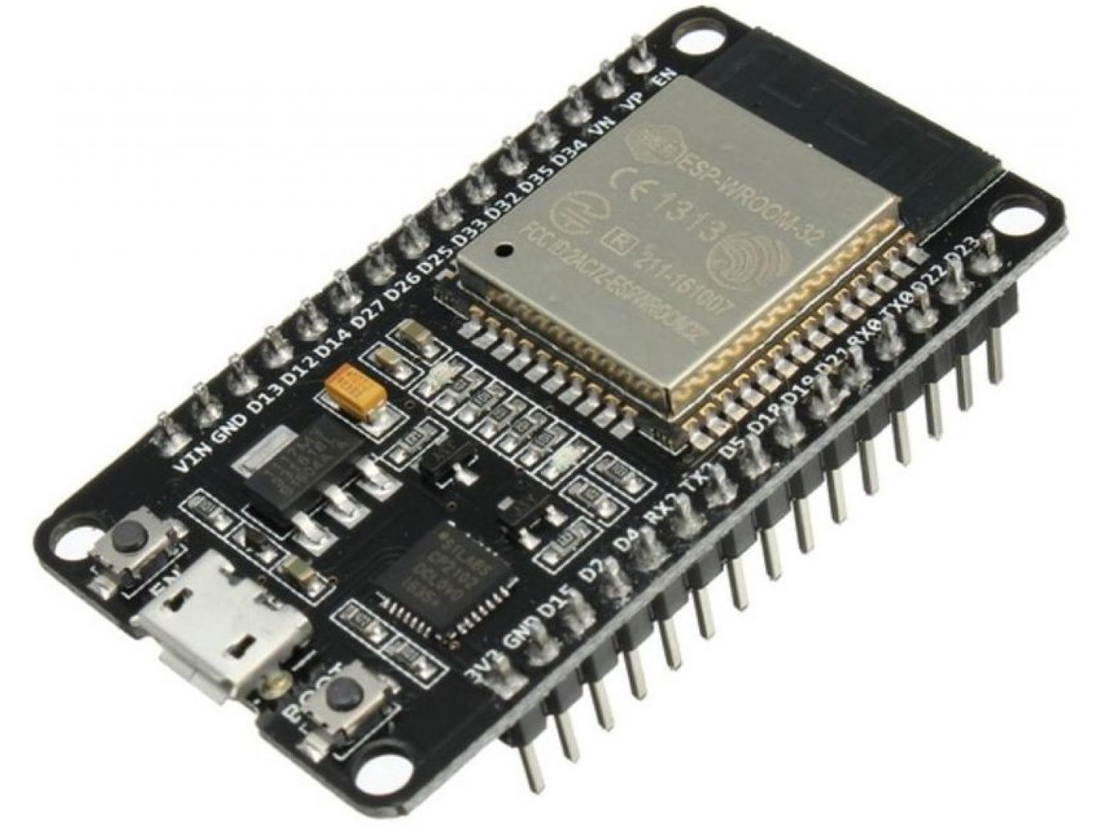
ESP32
The Superior Microcontroller

Slide 5

What Does it Mean by
Xtensa 32 Bit LX6
Microprocessors?
The number of bits (e.g., 8-bit, 16-bit, 32-bit, 64-bit) indicates how many bits of data the processor can process at once.
A 32-bit processor can handle 32 bits (4 bytes) of data in one operation, while a 64-bit processor can handle 64 bits (8 bytes).

Slide 6
Feature | ROM (Read-Only Memory) | Flash Memory
Purpose | Stores permanent, system-level instructions (e.g., bootloader) | Stores user programs, firmware, and data
Modifiability | Not easily modifiable (written during manufacturing) | Reprogrammable and erasable
Usage | Used for essential startup and low-level system functions | Used for firmware updates and storing applications
Size | Small (just enough for system instructions) | Larger (typically 4 MB or more in ESP32)
Volatility | Non-volatile (retains data when power is off) | Non-volatile (retains data when power is off)
Rewritability | Cannot be rewritten or updated frequently | Can be rewritten and updated multiple times
Example in ESP32 | Stores bootloader and essential startup code | Stores the user-uploaded program and firmware
Main Function | Provides the initial instructions for booting | Acts as general-purpose storage for programs and data

Slide 7

Find Out What Each is Used For in General

Slide 8
Interfacing Basics
What is interfacing?
Allowing Devices to Digitally or by Analog Means to Talk to Each Other
Types of signals:
Digital Input/Output (HIGH/LOW).
Analog Input (e.g., potentiometer).
PWM Output (e.g., motor speed control)

Slide 9

BASICALLY, CONNECTING DEVICES

Slide 10

Digital Input/Output
Digital Input: Reading binary signals (e.g., button press).

Slide 11
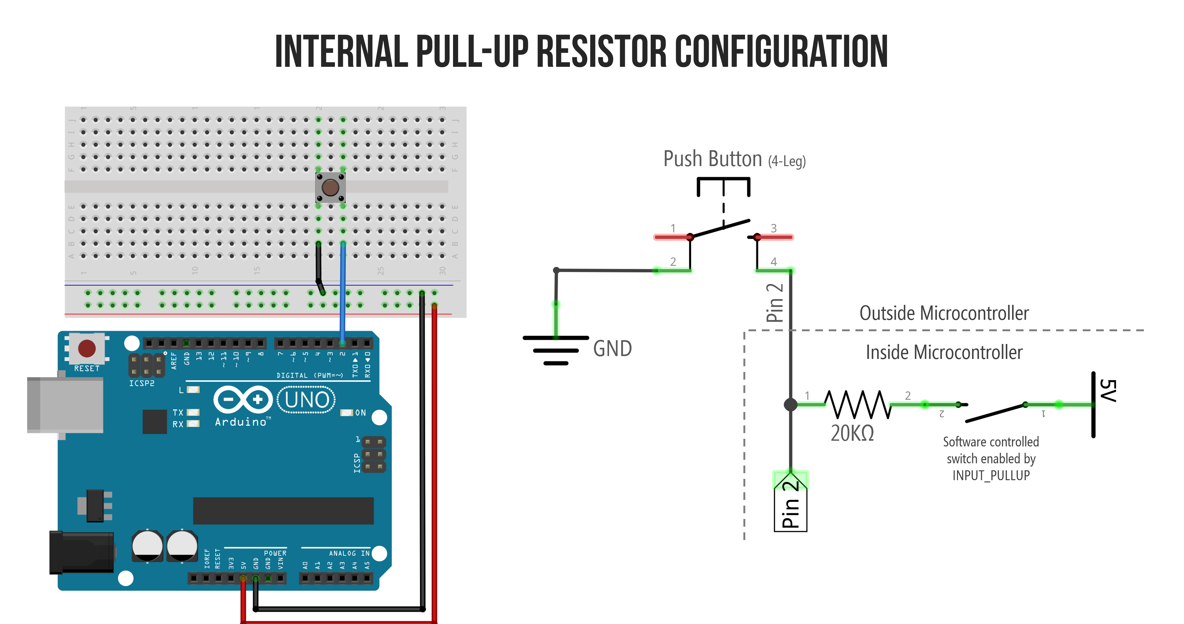

Slide 12
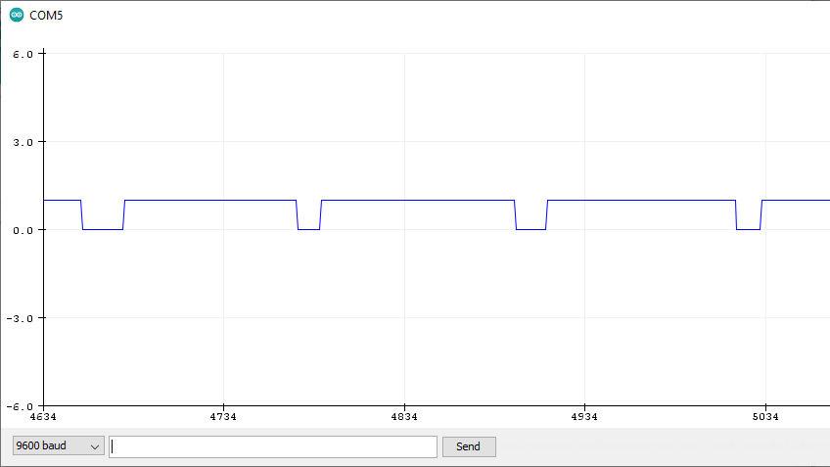

Slide 13
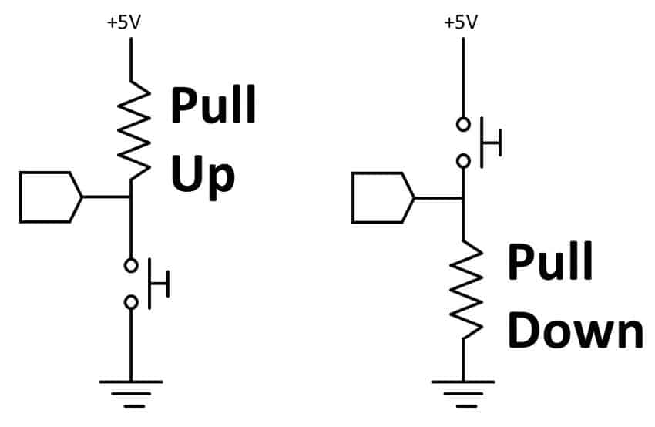

Slide 14
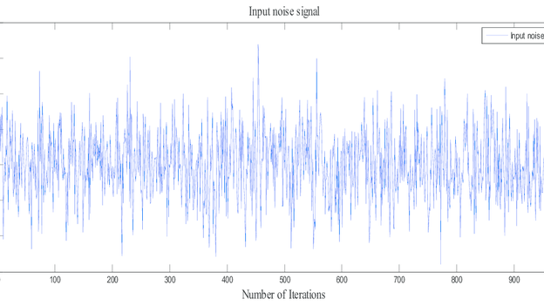

Slide 15
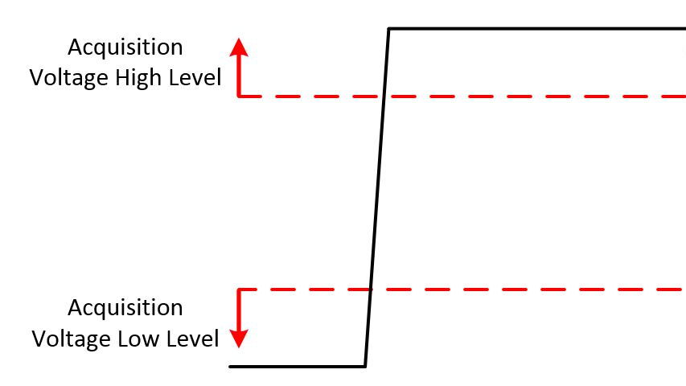

Slide 16

Digital Input/Output
Digital Input: Reading binary signals (e.g., button press).
Digital Output: Sending binary signals (e.g., turning an LED on/off).

Slide 17
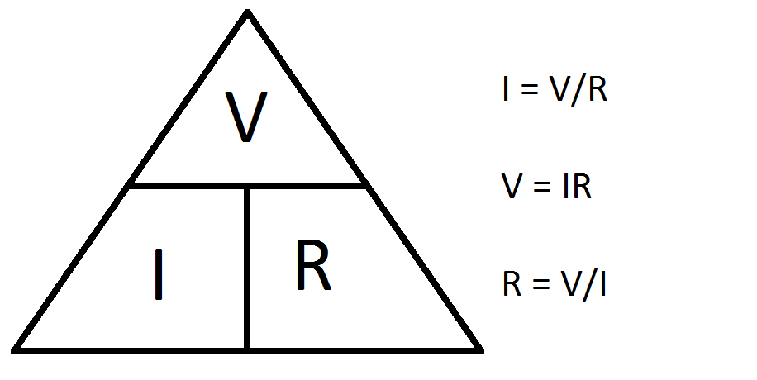
Output Is 3.3V 50mA Max

Slide 18
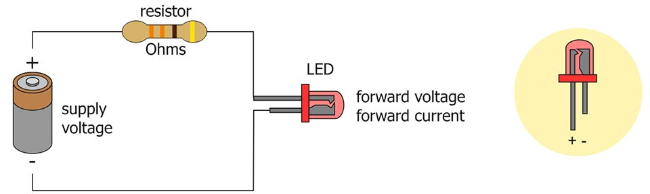
Output Is 3.3V 50mA Max
Calculate for 2.2V Red LED for 5mA Loading

Slide 19

Analog Input
It is not AC Voltage!

Slide 20
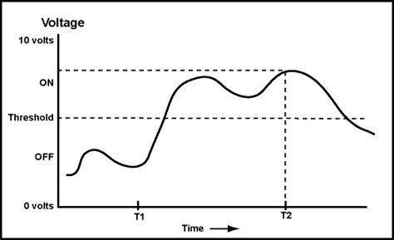

Slide 21
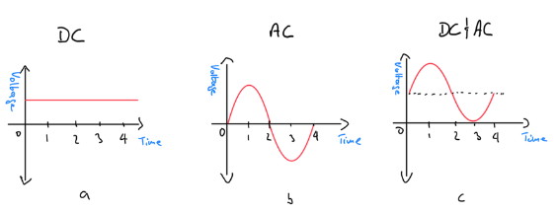

Slide 22

Analog Input
Reading continuous voltage levels (e.g., potentiometer, light sensor).
ESP32 has built-in ADC (Analog-to-Digital Converter).

Slide 23
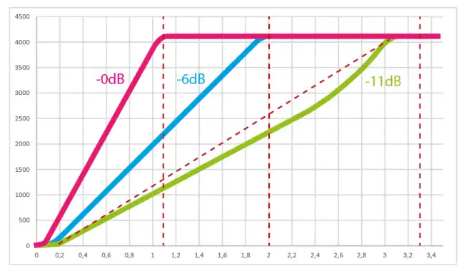

Slide 24
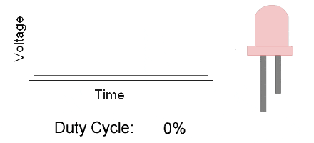
Analog Output (PWM)
Simulating analog output using digital signals.
Used for controlling motor speed, LED brightness, etc.

Slide 25
Analog Output (PWM)

Slide 26
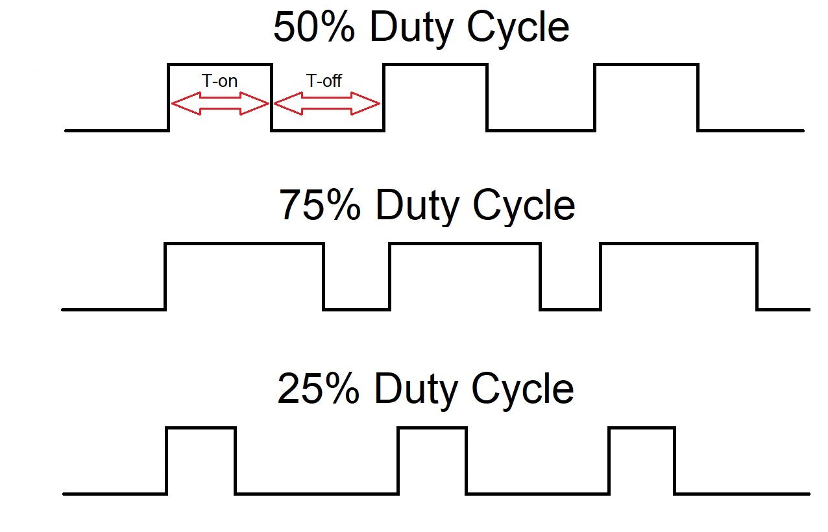

Slide 27
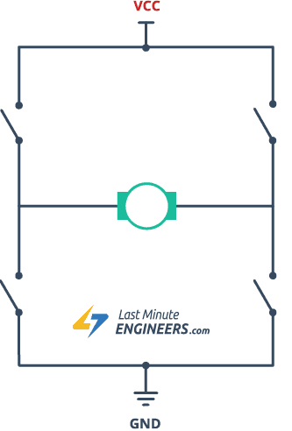
H-Bridge Motor Driving
H-Bridge: A circuit for controlling direction and speed of DC motors.
How it works:
  4 switches control current flow to the motor.
  Allows forward, reverse, and braking.

Slide 28
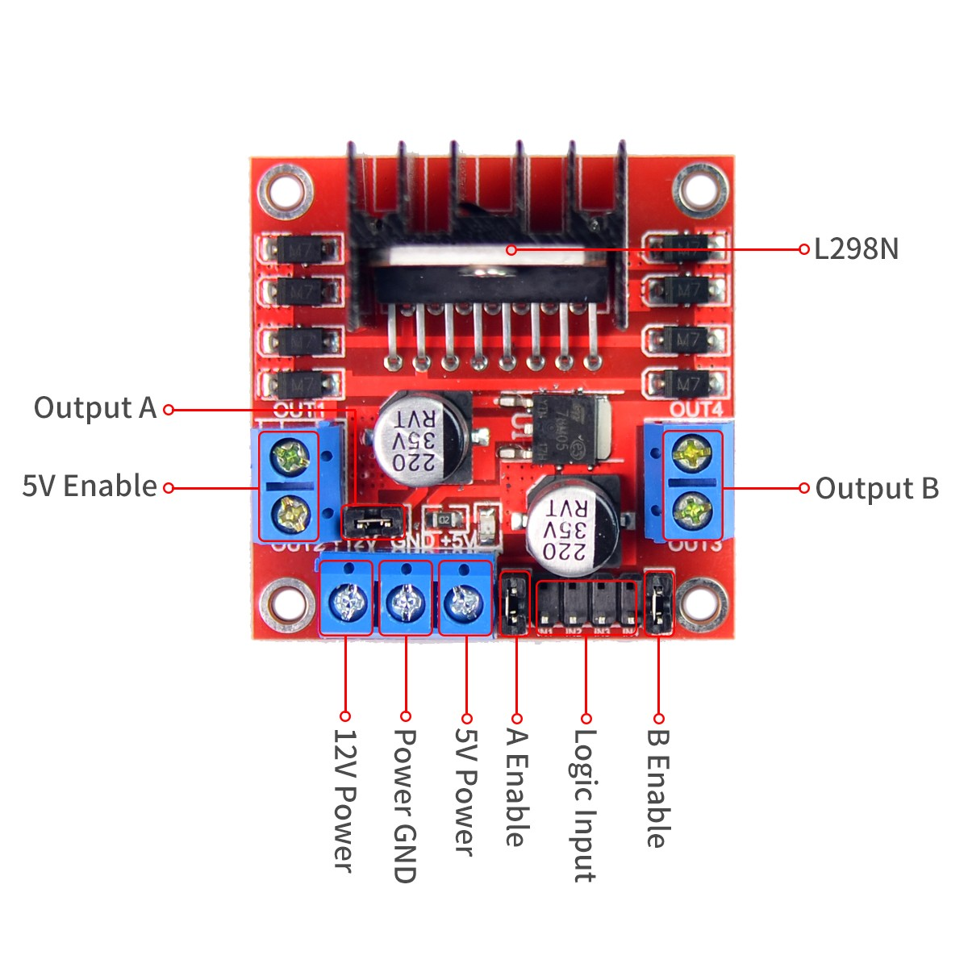
H-Bridge Motor Driver IC Board

Slide 29
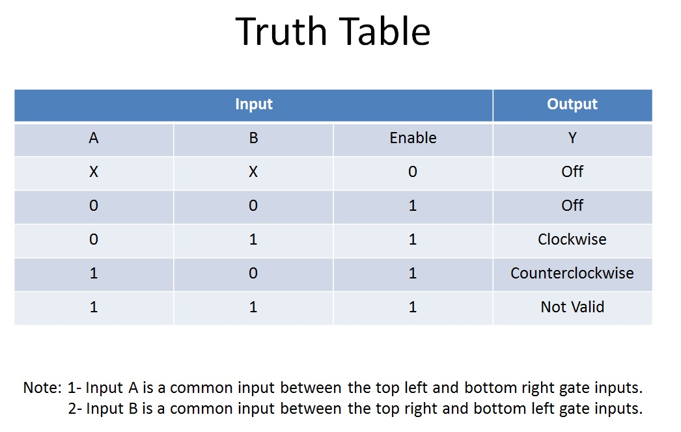

Slide 30

Simulation/Modelling

Slide 31

THANK YOU
Akbar Q – Mechatronics Engineering

